Slide 1
Living Data Workshop 3
Link to this slideshow: http://bit.ly/LDWS3-19
Notes:
1 minute
Encourage students to download PDF version/google drive version.

Slide 2
In Workshop 2
Loading data from a CSV file
Drawing with data
Capturing your own data
Notes:
2 minutes (0:3)

Slide 3
In the pre-work
You have:
Drawing a heatmap with data
Controlling colour with lerpColor()
Notes:
2 minutes (0:3)

Slide 4
In this workshop...
Making decisions with code
Making new types of visualisations
Notes:
2 minutes (0:3)

Slide 5
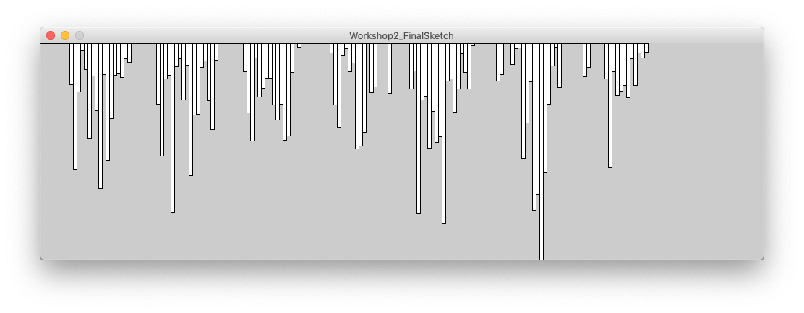
Last-time

Slide 6
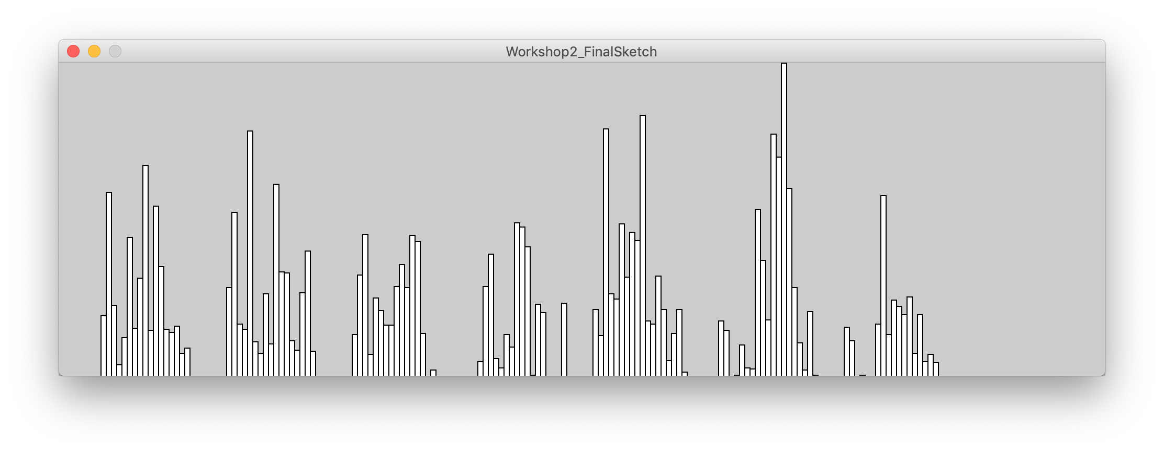
Did you flip the chart upside-down?
See Dropbox for the sketch code for this completed example

Slide 7
Conditional Statements
Allows you to have something happen, or not happen depending on the value of a variable.
If something is true
Then do some task

Slide 8
In real life
If we are out of bread
Then buy more bread
If we have not arrived
Ask if we are there yet?
These are too vague to turn into code:
What sort of bread?
Where are we going?

Slide 9
if() statements
In Processing, an if() statement lets us run code based on some condition.
They look a little bit like a for() loop (the conditions are used there too):
int value = 3;
if(value < 12) {
println("Value is less than 12");
}
Code inside these brackets runs only when the condition is true

Slide 10
Creating if() statements
int value = 3;
if(value < 12) {
}
But what goes in here?
First thing - just type out the opening and closing brackets and make sure they are in the right place
Then start to work on the code inside
Easier to keep track of in your head

Slide 11
Types of conditionals
Examples:
int value = 3;
value < 12 true
value > 0 true
value == 3 true
value <= 3 true
value >= 12 false
value != 13 true
< Less than
> Greater than
== Equal to (note two-equal signs)
<= Less than or equal to
>= Greater than or equal to
!= Not equal to

Slide 12
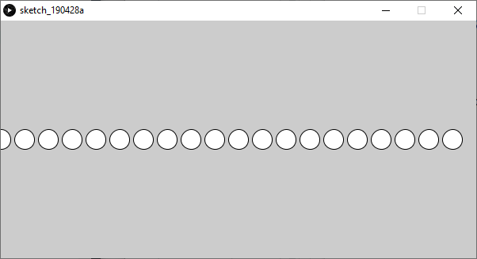
Worked Example
size(600, 300);
for(int i=0; i<20; i++ ) {
circle(i*30, 150, 25);
}
What if we want the 5th circle to be red?

Slide 13
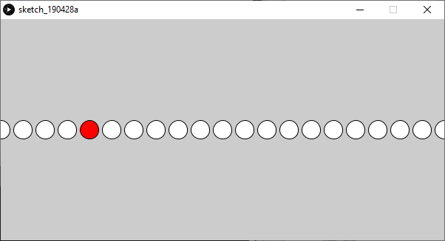
Worked Example
size(600, 300);
circle(0, 150, 25);
circle(30, 150, 25);
circle(60, 150, 25);
circle(90, 150, 25);
fill(255,0,0);
circle(120, 150, 25);
fill(255);
circle(150, 150, 25);
circle(180, 150, 25);
This works, but I now have to write 30 circles.
Want to change the size or the spacing?
Have fun. With that.

Slide 14
Worked Example
size(600, 300);
for(int i=0; i<20; i++) {
if( i == 4 ) {
fill(255, 0, 0);
}
circle(i*30, 150, 25);
}
?
Will this work?
What will happen?
Why are we testing for i == 4 ?
Discuss ways to make this work better?

Slide 15
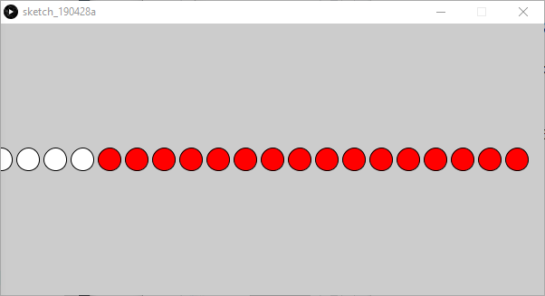
Worked Example
size(600, 300);
for(int i=0; i<20; i++) {
if( i == 4 ) {
fill(255, 0, 0);
}
circle(i*30, 150, 25);
}
Nope…
Once we set the color to red, all the circles are red.

Slide 16
else statements
To get this example working, we need one more thing.
We can now test for a condition, but what about the rest of the time when that condition doesn’t apply?
The else statement lets us deal with this.
else does not take a condition - it runs whenever the original condition isn't true.
Now the circle will be white, except for the 5th circle which will be red.
size(600, 300);
for(int i=0; i<20; i++) {
if( i==4 ) {
fill(255, 0, 0);
}
else {
fill(255, 255, 255);
}
circle(i*30, 150, 25);
}

Slide 17
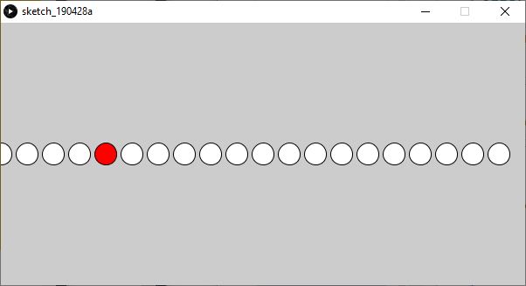
Worked Example with else
size(600, 300);
for(int i=0; i<20; i++) {
if( i==4 ) {
fill(255, 0, 0);
}
else {
fill(255, 255, 255);
}
circle(i*30, 150, 25);
}
It works!

Slide 18
else statements
We can get the same outcome, by writing our conditional test another way.
How can we change the if() statement and rearrange our code to do this?
Hint: Change only the blue code, and rearrange the red code.
size(600, 300);
for(int i=0; i<20; i++) {
if( i == 4 ) {
fill(255, 0, 0);
}
else {
fill(255, 255, 255);
}
circle(i*30, 150, 25);
}

Slide 19
else statements
By changing the conditional test to i != 4 and swapping the contents of the two sets of brackets, we achieve the same outcome.
size(600, 300);
for(int i=0; i<20; i++) {
if( i != 4 ) {
fill(255, 255, 255);
}
else {
fill(255, 0, 0);
}
circle(i*30, 150, 25);
}

Slide 20
Downloading your steps data
iPhone using QSAccess
Instructions at ________
Watch the walkthrough video
Android using Accupedo
Instructions at _______
Watch the walkthrough video

